Slide 1
September 11th Fund Board
Meeting

Slide 2
Activities to Date:
Emergency Grants
All grants to date have been made under emergency guidelines & procedures
All proposals reviewed by joint teams of NY Community Trust & United Way staff
Proposals must be approved by management and Board members (>$300K) of both agencies
Sept. 12 - 15: UW & NYCT host series of meetings with disaster relief and other nonprofit agencies
Sept. 14 Family Assistance Center opens at the Lexington Avenue armory
Sept. 15-18: UW & NYCT alert key service providers of available funds
Sept. 16 Expanded Family Assistance Center relocated to Pier 94
Sept. 19: First proposals received
Sept. 21: Availability of emergency funds discussed with Safe Horizon
Sept. 21: Notice of Available Funds (NOFA) broadly distributed for proposals meeting immediate & emergency needs. Eligible:
        Agencies serving those who lost family members, their homes or jobs & the larger community affected by the disaster
        Agencies re-granting to such organizations
        Nonprofit organizations directly victimized
Sept. 22: Safe Horizon distributes first checks to victims using September 11th Fund money

Slide 3
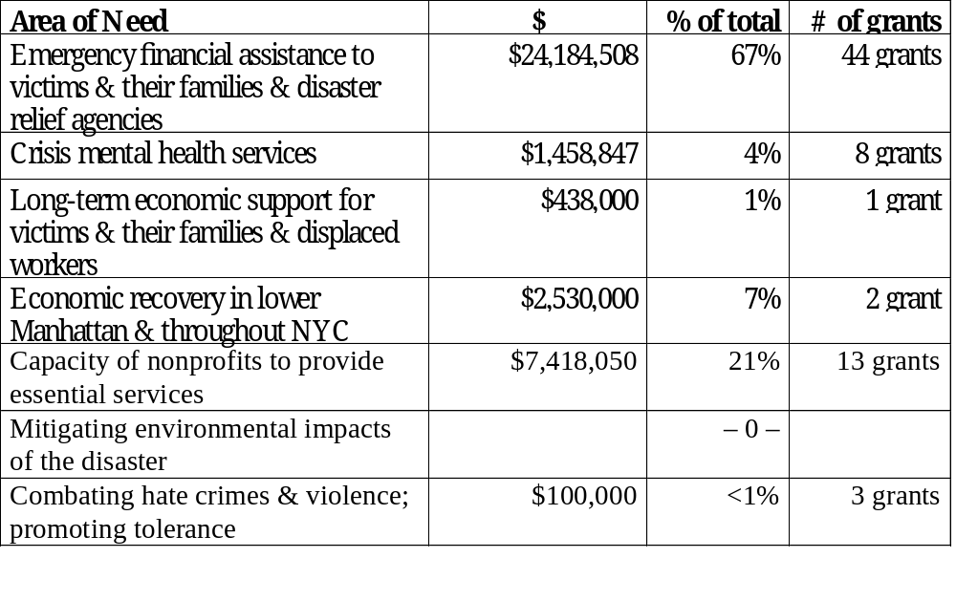
Activities to Date:
Emergency Grants by Area of Need
71 emergency grants to date totaling $36.1 million
$3.7 million granted through 18 local United Way chapters outside NYC

Slide 4
Activities to Date:
Results
More than 12,000 checks to individual victims/families for rent, utilities, etc.
Up to 10,000 meals served per day at Ground Zero
>4,600 people received crisis counseling
>2,000 adults and children, including 700 rescue workers, received disaster mental health services
>1,000 people met with career advisors
>500 children counseled in bereavement groups
3 new ambulances & enhanced training for 34 volunteer ambulance corps
Comprehensive Resource Referral Guide created for individuals, families, businesses and agencies seeking information and assistance on disaster relief for use at Family Assistance Center & throughout the city
Toll-free hotlines established

Slide 5
PROCESS FOR SETTING PRIORITIES

Slide 6
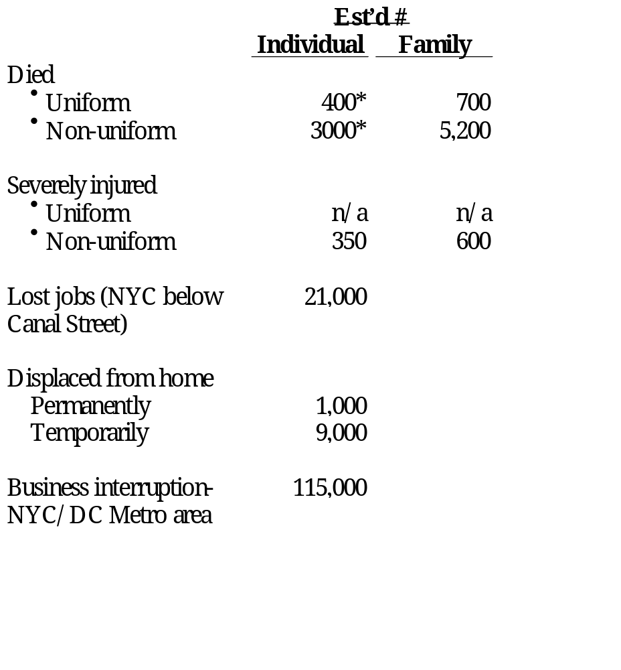
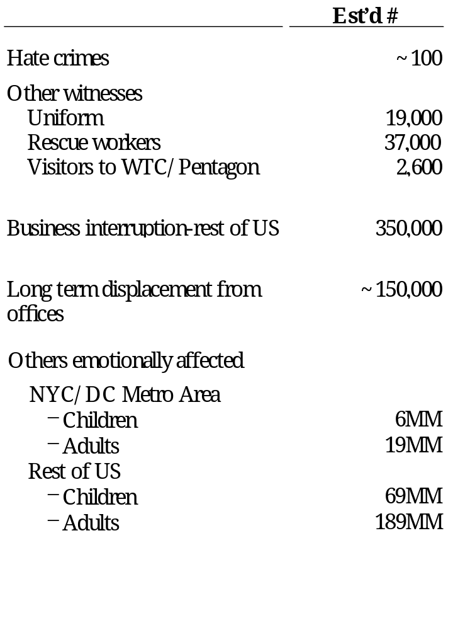
Who’s Affected? Defining “Victim”
* Figures updated 12/06/01 to reflect latest estimates (source: New York Times)
Source: CNN; NY Post; Pentagon Public Affairs; FDNY/NYPD Affairs; FEMA; Hevesi report; Fiscal Policy Institute; BPC association; FBI hate crimes statistics; NY Times; McKinsey analysis

Slide 7
Small Businesses & Nonprofits also are affected
Small Businesses*
Category __ __Est’d
  Lost Facilities ~2,000
  Disrupted (below Canal) ~14,000
  Lost revenue (NYC) ~600,000
Nonprofits
Category______________ _ Est’d
  Lost Facilities ~100
  Disrupted (below Canal) ~1,000
  Provided emergency goods/services ~100
  Lost revenue (NYC) ~15,000
*Estimates are for nonprofits and small businesses in NYC only; Small business is defined as having under 500 employees.
Source: Hevesi report; Guidestar; U.S. Census; Small Business Administration; US Census; NY Business Development Corporation; Office of the NY Attorney General

Slide 8
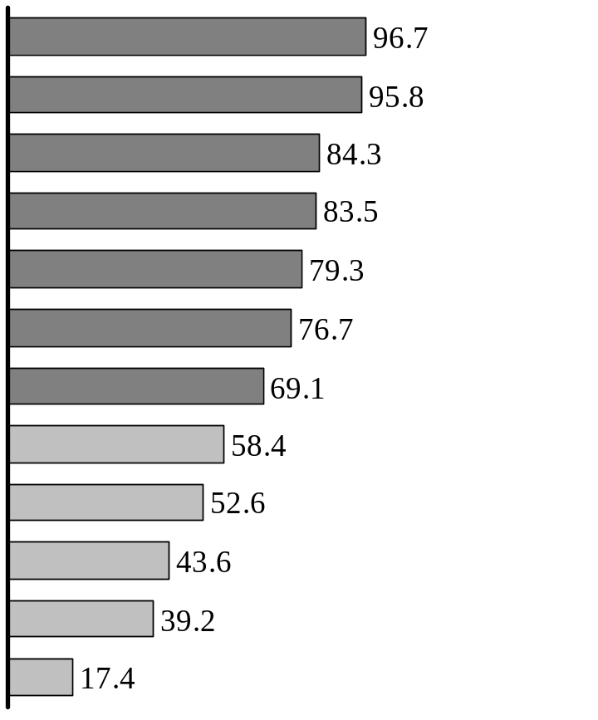
General Public Views
“Who should get support?”
% Respondents supporting*
Spouse and children of those who lost their lives
Suffered physical harm as result of attacks
Displaced from home as result of collapse
Rescue workers involved in aftermath
Lost jobs in collapsed/evacuated buildings
Escaped from collapse and need support and counseling
Residents of affected areas who lost wages as result of attacks
Children in need of help in dealing with tragedy
All those in need of support or counseling
Respondents believe those directly affected by tragedy (e.g., at site of attacks, live/work on-site) should receive support
Those who suffered from hate crimes as result
of attacks
Lost business operations as direct result of attacks
Those afraid to continue to work at job
*Interviews were conducted with the general public, including self-described donors, and may not reflect the opinion of other donors.
Source: Lightspeed online survey (10/1) N = 1,182

Slide 9
Institutional & Other Donors’ Views
“We split a $3 MM donation equally between three funds in order to address three different types of victims. We gave to the Twin Towers Fund for firefighters and police, the Star Ledger Fund for NJ victims, and the Sept. 11th Fund for everyone else.”
“We are confident that you are best suited to provide immediate support to the most trusted nonprofit organizations that are serving the most urgent needs.”
Foundations
“This is a time that requires that our community join together ... to help sustain those who have suffered most and to help rebuild our City. We have great respect for the expertise that your organizations bring to this most
difficult task.”
“We contributed to you because we trust your expertise. We’re confident you’ll put the funds to their best use, however you choose to distribute them.”
Corporations
“I worry about the ‘invisible victim’. The 9/11 Fund is casting a wider net than just the high publicity areas, which in my mind is a positive. If I only wanted to donate money to firefighters, I would have donated to the Fireman’s Fund.”
“I know you will get the victim classes right. My concern is that with so many funds out there, certain groups will get too much while others will be overlooked.”
High net worth
individuals
Source: Phone interviews

Slide 10
How to Help? Defining the Range of Needs
For Individuals & Families:
Cash for immediate needs: rent, utilities, etc.
Cash compensation for loss
Counseling & mental health
Job training & referral
Child care
Health care
Scholarships
Community education: tolerance, anti-bias, ethics
Legal & financial advice
For Small Businesses & Nonprofits:
Legal & financial advice
Facilities & equipment
Compensation for emergency goods/services provided
Lost revenue/ fundraising

Slide 11
Preliminary Needs & Gap Assessment
Illustrative Classes of Victims
Those who were physically harmed as a result of the attacks on September 11th and their families
Primary
Those experiencing trauma & economic, not physical, harm due to their physical proximity to the WTC/Pentagon
Secondary
All others adversely affected by the events of September 11th
Tertiary
For purposes of analysis only. Other classifications are entirely possible.

Slide 12
Categories of Assistance for Individuals & Families
Immediate relief
Food
Clothing
Shelter
Other pressing necessities
Cash or in-kind donations to victims and families for subsistence needs, including rental/mortgage payments, funeral expenses and other necessities arising from the tragedy
Compensation
Death
Injury
Job loss
Housing loss
Remuneration for losses
Other Aid to Rebuild & Renew
Counseling
Childcare
Legal/financial
services
Scholarships
Training
Healthcare
Community education
Grief counseling and psychotherapy
Child care for those families who lost members or their jobs
Consultations with lawyers and financial planners
Offer of college and K-12 educational assistance
Job placement services and/or retraining
Payment of normal health care costs of victims and families
Information materials and courses to educate and comfort on various topics (e.g., tolerance, anti-violence)
Source: Oklahoma City United Way; Safe Horizons; Lockerbie bombing analysis; Hevesi report; NYS Department of Health; UWNYC; DeVry Institute; Rotary Club; Magazine Publishers of America

Slide 13
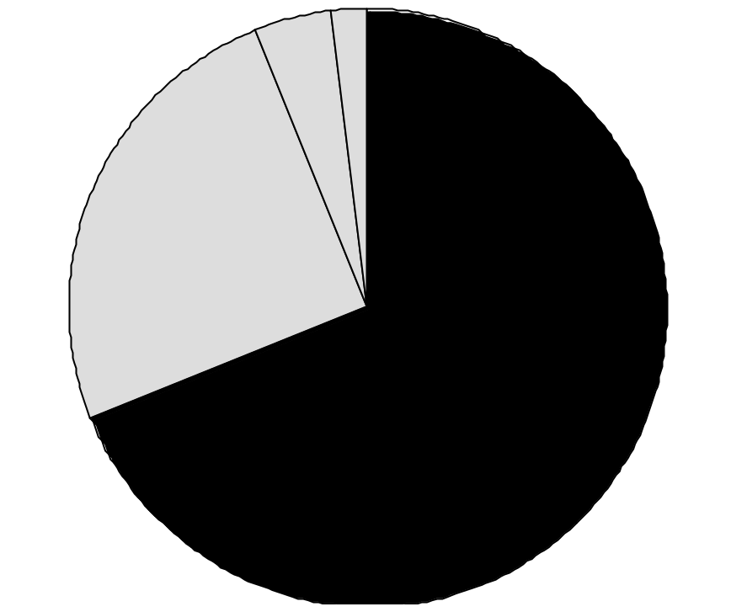
Funds Available for Individuals & Families
(millions)
Total ≅ $16 Billion (As of October 15^{th,} 2001 )
Special purpose/restricted
charitable funds, e.g.
Twin Towers Fund: $75 MM (Uniformed Services)
Citigroup Relief Fund: $15 MM (scholarships)
NY Police and Firefighter Widows’ and Children’s Fund: $10M
General purpose
charitable funds, e.g.
Sept 11 Fund: $335M
American Red Cross: $100 MM*
NY Times Neediest Cases Fund: $35 MM
Robin Hood Foundation: $28MM
$200 (1%)
$700 (4%)
$4,000 (25%)
Private insurance***
~$11,000 (70%)
Government funds
and agencies, e.g.
Airline Bill: $6B**
NY State Dept of Labor: $2.6B
Social Security: $1B
Airline recovery portion of gov’t funds: $6,000
* Since 10/15, Red Cross has raised >$500 MM, with $100MM dedicated to cash compensation for Sept 11th relief and $100MM to other direct relief.
** The airline bill is $15 B, $5B in cash to the airlines and $10 in loan guarantees. It is expected that out of that $15B, each family of a deceased or severely injured victim will receive approximately $1MM. Therefore, we estimate that the airline bill portion dedicated to victims is $6B.
***Based on average of estimates provided by the American Council of Life Insurers & the NYC Comptroller’s Report
Source: Robin Hood Foundation; FEMA; OMB; Hevesi report; Dow Jones Interactive; literature search

Slide 14
Potential Gaps in Meeting Needs of Individuals & Families*
Extent of gap
Low estimate of need
<20% met
High estimate of need
20-70% somewhat
> 70% substantially
Needs
$ Millions
Victims
Immediate relief
Compensation
Rebuild & renew
Primary
6,000
  100
  400**
  500
  200
  15,800**
  2,900
  400
  1,000
  2,200
Secondary
70,000
  1,100
  2,100
  5,500
  200
  400
Tertiary
283,300,000
  N/A
  500
  2,500
Immediate needs likely to be met irrespective of estimates
Compensation needs likely to be met except in highest estimate
Rebuilding & renewal likely to be substantially unmet
* Identified gaps based only on funds with specific designations. This does not included general funds such as September 11th Fund.
** The compensation figures range significantly. In the low case, compensation is based on basic insurance levels. In the high case, compensation is based on the average of the Lockerbie bombing and TWA 800 settlements.
Source: McKinsey analysis

Slide 15
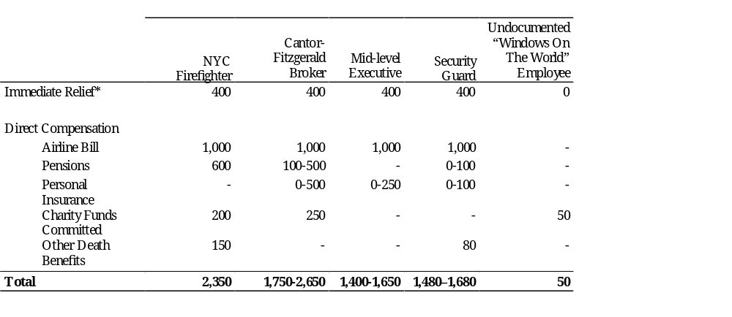
Cash Compensation Issues:
Significant Disparity of Compensation
For victims who died in the WTC/Pentagon, direct compensation excluding the airline bill could range between $50K - $1.65 M
In thousands $$
* Immediate relief includes, but is not limited to, funds provided by the following agencies: Crime Victims Board ($30K), Social Security ($160K NPV over 30 years), Workers Comp. Board ($180K lump sum), and FEMA ($14K). Other non-governmental entities (e.g., Sept 11 Fund through Safe Horizons) have provided emergency funds to individuals, including undocumented workers, on a case-by-case basis
Source: CVB; SSB; WCB; FEMA; NY Times; Hevesi Report; McKinsey analysis

Slide 16
Options for Cash Compensation
Survey respondents favor cash for immediate relief &
other services (e.g. counseling) over long-
term cash compensation (e.g. death benefits)
Option 1: Compensation to Families of Deceased Based on Need
Majority of families will receive > $1M from govt sources, special-purpose funds & private insurance
More funds available for other assistance (e.g. mental health)
Could be sole source of funding for families ineligible for gov’t. support
Less disparity in total cash received by families
Limited coverage of primary victims
Disappoint donors intending to provide cash to all survivors
Please donors expecting to meet broader range of community needs
May appear to favor groups with less public support (e.g. undocumented workers)
Requires knowledge of other aid received
Requires individual case work & trusted intermediary
Option 2: Compensation to Families of Deceased, Regardless of Need
Compensate for loss, need-blind
Intention of many donors
More disparity in total cash received by families
Universal coverage of primary victims
Please donors intending to provide cash to survivors
Disappoint donors expecting to meet range of community needs
Requires list of eligible families
May require IRS determination to avoid violating charitable status
Rationale
Equity implications
Support/
Opposition
Implementation Issues

Slide 17
Bridging the Financial Gap Over Time Also Raises Issues of Equity
(Illustrative)
Dollars/month
Potential gap
Over 85% of survey respondents view interest-free loans as appropriate response to government funding time gap
25,000
Airline bill ≅
$1MM per victim or more
FEMA support for burial, legal, and material costs
20,000
Compensation*** from federal airline bill uncertain in timing or amount
15,000
10,000
End of crime victim board support
Family expenses*
5,000
Immediate relief**
0
Oct-01
Apr-02
Oct-02
Apr-03
Oct-03
* Family expenses have been defined from a cash flow perspective. Since the average U.S. household does not save any money, we assumed that income equaled expenses. Accordingly to the NYC Comptroller report, the average salary for a WTC employee was $100,000, which we grew at 5% annually and tax affected at 31%.
** Immediate relief as supplied by CVB ($2400/month), SSA ($1400/month), worker’s compensation ($1600/month), and FEMA ($14,400). Does not include any private insurance or charity.
*** While the federal government has promised swift distribution of compensation, historical experience does not support that claim.
Source: McKinsey analysis

Slide 18
Who’s Falling Through the Cracks?
Est’d
Est’d
Primary
Secondary
Victims
Victims
Total
Ÿ
Undocumented
100
9,900
10,000
workers and their
families
Ÿ
Non-U.S. citizens and
1,800
18,200
20,000
their families
Ÿ
104
6,896
Unmarried partners
7,000
Ÿ
300
19,700
Multiple families
20,000
Initial surveys suggest support (>2/3) for all groups except undocumented workers.
Less than 1/4 survey respondents favor support to this group.
Source: McKinsey analysis

Slide 19
Lessons from the Oklahoma City Bombing Experience
Carey Williams, Director of OKC National Memorial:
“While it took 3-4 years to distribute most funds raised for victims of the OKC tragedy, we are still disbursing funds”
Nancy Anthony, Director, OKC Community Foundation
“This is not about dishing out money; it’s about helping people rebuild their lives, and that takes time”
“End the ‘divide the pot’ mentality”
“We don’t bring calculators and checkbooks; we bring expertise”
Dan Kurtenbach, Resource Coordination Committee, OKC:
“The majority of our work and our value to the community has been supporting long-term needs. You will not know what those needs are for at least a year.”
Bob Spinks, United Way of OKC:
“We are still supporting the victims of OKC. We recently funded counseling for a reporter who covered the tragedy. His support was six years in the making.”

Slide 20
Other Issues for Possible Consideration
Mental health/counseling
Reconstruction/infrastructure
Local economic development/small business support
Anti-bias
Nonprofits
Job training/placement
Legal services
Health care
Environmental effects
Effects of follow-on terrorist activities (e.g. anthrax)
Education/scholarships
Other areas of Board interest

Slide 21
Proposed Grant Review & Approval Process
Board role: Prior approval of overall policies & resource allocations
Procedure
Proposals received by September 11th Fund
Proposals reviewed by staff of September 11th Fund, United Way & NY Community Trust
Staff make recommendation for grant or declination to September 11th Fund
CEO approves all grants up to $300,000
Chairman approves all grants from $300K - $5M
Board approves all grants above $5M

Slide 22
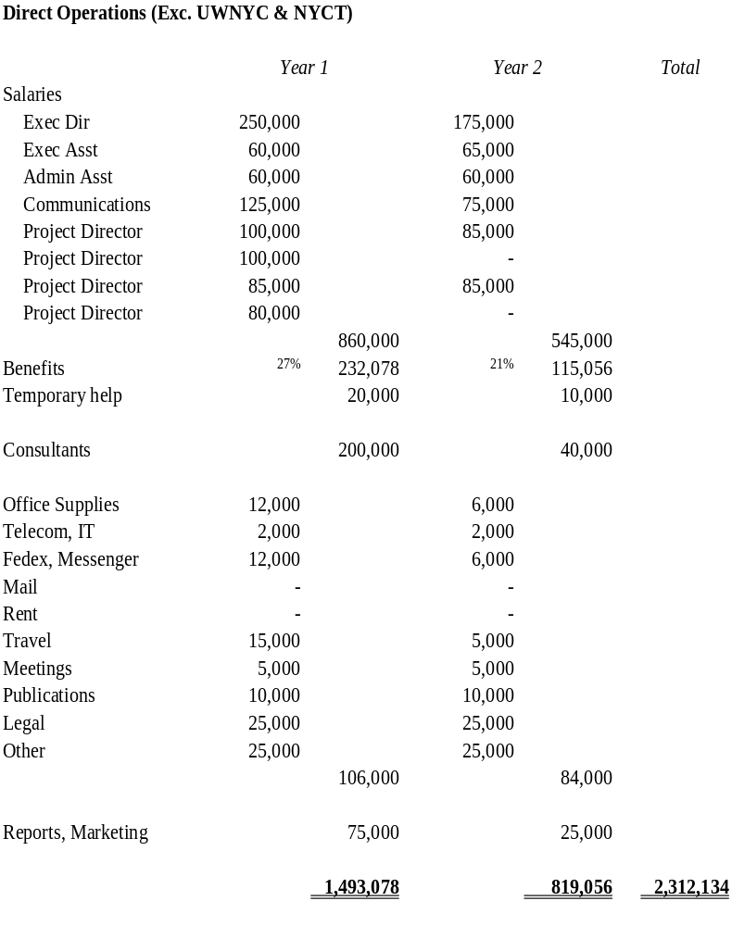
Proposed Budget
September 11th Fund to be operated as a small organization that relies heavily on services donated by NY Community Trust, United Way and others.
First year involves program development and grantmaking. Second year activity primarily limited to monitoring with reduced staff.
United Way will continue to provide receipt and acknowledgement of donations, accounting, grant review, cash disbursement for grants, and communications support for the September 11th Fund.
NYCT will continue to provide receipt and acknowledgement of donations, grant review, space, fundraising for administrative costs and other support for the September 11th Fund.

Slide 23
Next Steps
Refine Analyses of Victims, Needs & Gaps
Coordinate with Government & Other Funders
Develop Cash Compensation Options & Strategy
Develop Options for Priority Areas
Next Board Meetings:
  Monday, Nov. 19 or Tuesday, Nov. 20
  Thursday, Dec. 6 or Friday, Dec. 7
  Thursday, Dec. 20 or Friday, Dec. 21
  Wednesday, Jan. 16 or Thursday, Jan. 17

